Slide 1
Starbuck Survey Analysis
Customer Retention
Clem Mbote
Notes:
1) My presentation is based on responses to a survey completed by Starbucks customers.
And from the responses,

Slide 2
Objectives:
To build a classification machine learning model that predicts whether or not a customer will return
To build a clustering machine learning model that identifies the characteristic of customers who will not return
Notes:
2 Objectives
1) I will be reviewing a classification model that predict whether or not a customer will revisit a Starbuck’s store
2) ….a clustering model that identifies the characteristic of customers who will not return

Slide 3
Dataset Description:
Dataset is composed of survey questions with over 1000 respondents
Data Content:
Categorical Columns are:
Gender
Age
Status
Income
Frequency of Visit
Mode of Visitation
Time Spent in Store
Starbucks Membership
Purchase Cost Range
Purchase
Promo Method
“Will you come back?”
Numeric Columns are: (1-5)
Product Quality
Price Range
Importance of Sales/Promotions
Ambiance
WiFi Quality
Service
Notes:
1) Dataset is composed of survey questions from over 1000 respondents
Data content is as follows 12 – Categorical Columns 6 – Numeric Columns 18 in total
My ‘target’ or y variable is the feature “Will you come back?

Slide 4
Top 10 Features as measured by Chi^2
Feature: Score:
Price Range 22.19
Purchase Cost 16.51
Membership Card 11.18
Product Quality 8.98
Ambiance 5.05
Purchase 3.14
Status 3.12
WiFi Quality 1.74
Service 1.71
Visit 0.88
Notes:
1) To help decrease the number of features, I found the Chi^2 measurement for all and list the top 10. Ideally, the best features to use in a machine learning model are the features which are highly dependent on the responses. And the Chi-Square value measures a features dependence on the reponses. Thus the higher the Chi^2 value, the more ideal the feature is for model training

Slide 5
Classification Methods with Top 10 Features on “test” Data
Classifier: Accuracy Score: w/ Hypertuning:
Random Forest Classifier 83.64% 92.06%
KNN Classifier 100.00% 100.00%
Gradient Boosting Classifier 100.00% 100.00%
XG Boost Classifier 100.00% 87.38%
Logistic Regression Classifier 77.10% 77.10%
Voting Classification Accuracy Score: 100.00%
Notes:
With the top 10 features, I ran 5 classification models on the test data
· Accuracy Score
· Hypertuning
· Voting Classifcation Accuracy Score

Slide 6
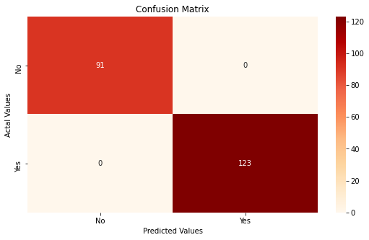
Confusion Matrix on test data:
123 predicted correctly would revisit Starbucks
91 predicted correctly would not revisit Starbucks
Notes:
Confusion Matrix on test data
· 123 predicted correctly would revisit Starbucks
· 91 predicted correctly would not visit Starbucks

Slide 7
Identify the characteristics of the customers that indicated that they would not return.
We do this using K_Means Clustering
Notes:
How to identify the type of customer that would not be a repeat customer -K_Means Clustering

Slide 8
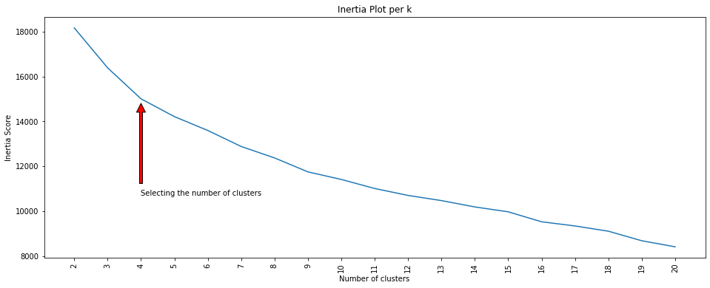
Identifying the ideal number of clusters by inertia
Notes:
First need to identify the ideal number of clusters by measuring inertia per # of clusters - Four clusters appear to be the ideal # of clusters

Slide 9
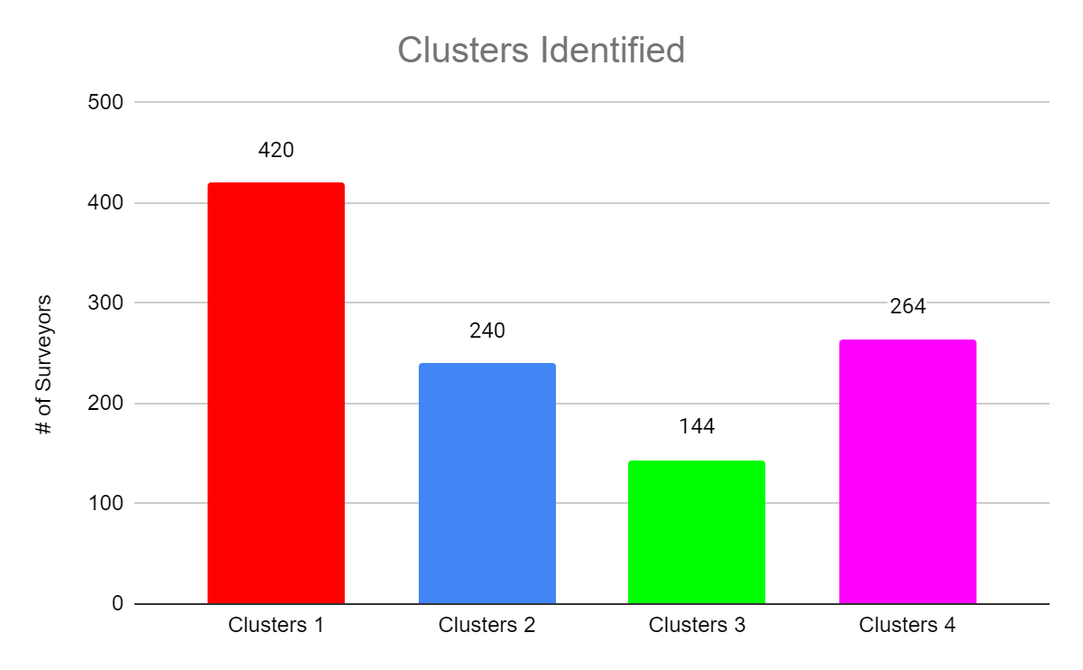
data['Clusters Category'].value_counts()
Cluster 1 420
Cluster 4 264
Cluster 2 240
Cluster 3 144
Name: Clusters Category, dtype: int64
Notes:
Clusters Identified – Cluster 1 is the largest

Slide 10
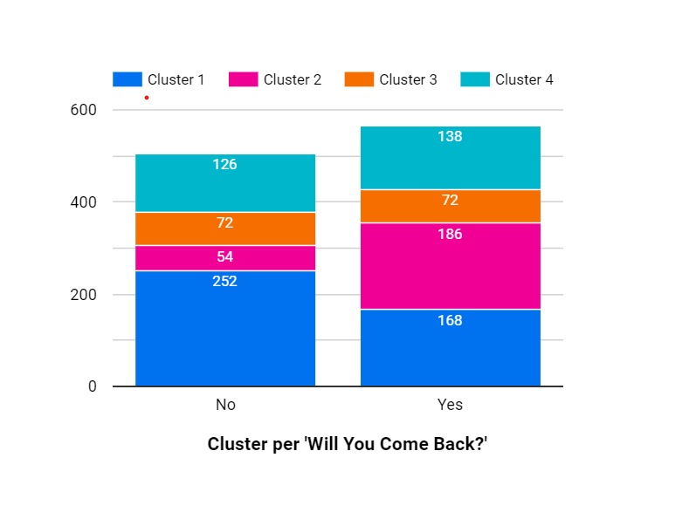
Clusters per “Will You Come Back?”
Notes:
How the clusters break out per whether or not the surveyor would return as a repeat customer
So we see cluster 1 had the largest population of “no” respondents (50%), followed by cluster 4(25%)
Now we need to identify the traits of each cluster

Slide 11
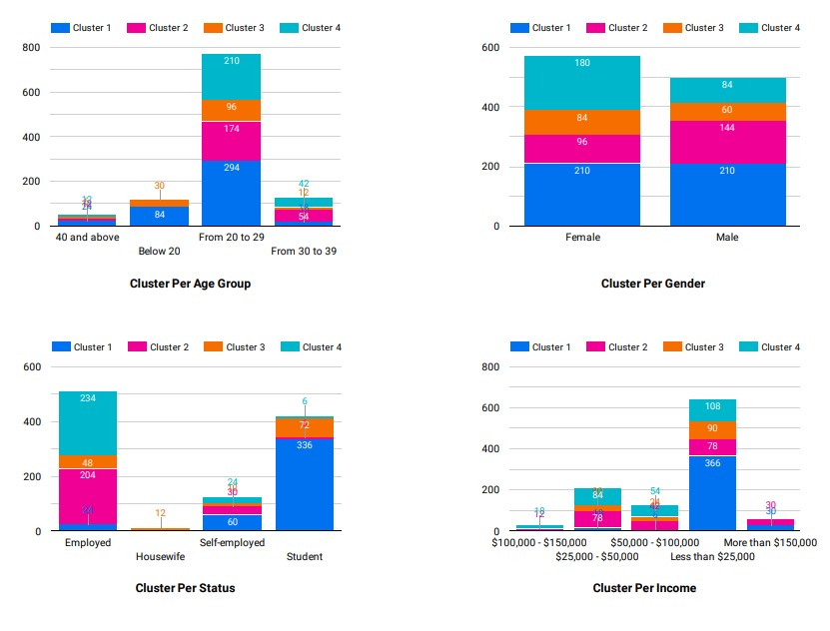
Notes:
) So to do that I graphed every feature by item, by cluster, here are four, but I do them for all.
For age group, we can see that 20-29, is largest age group for all of 4 of the clusters
For Status, Cluster 1 is made up of mostly students, while Cluster’s 2 and 4 are mostly employed customers
So I do this review for all of the features to define each cluster’s traits

Slide 12
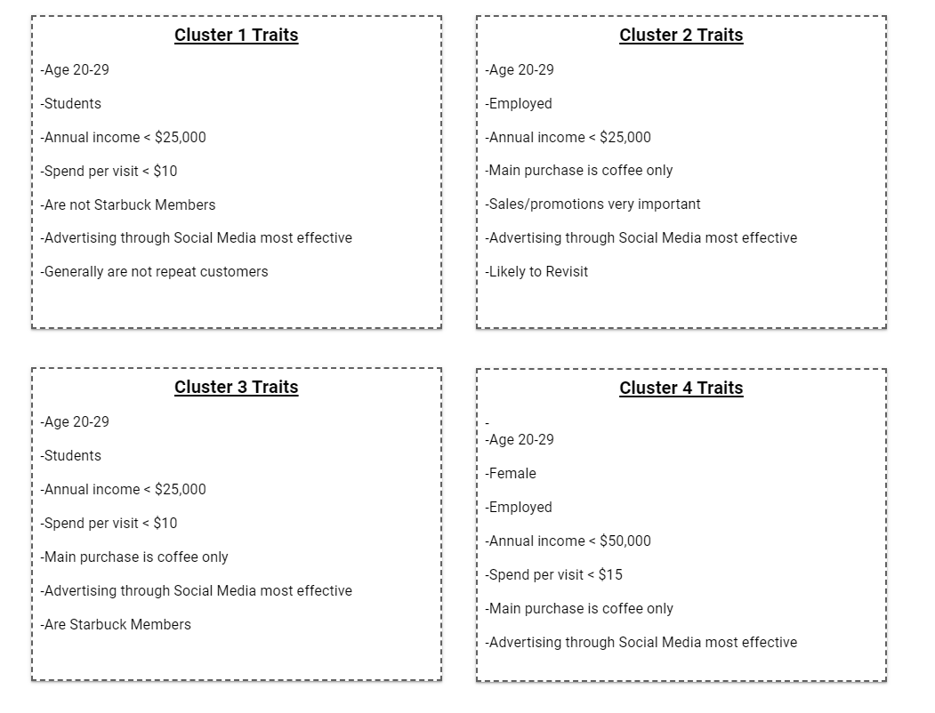
Cluster Traits
Notes:
And these are the character traits for each cluster

Slide 13
Summary
Cluster 1 make up 50% of the respondents who indicated that they would not return as a customer
Thus feature promos should be geared towards these customers
Cluster 1 Traits
-Age 20-29
-Students
-Annual income < $25,000
-Spend per visit < $10
-Are not Starbuck Members
-Advertising through Social Media most effective
Notes:
Summary

